Slide 1
CSE 12 – Basic Data Structures and Object-Oriented Design Lecture 23
Greg Miranda & Paul Cao, Winter 2021
This lecture is being recorded

Slide 2
Announcements
Quiz 23 due Monday @ 8am
Survey 9 due tonight @ 11:59pm
PA8 due Thursday, March 11th @ 11:59pm
No resubmission
PA7 Resubmission due Friday, March 12th @ 11:59pm
Final Exam
Starts Saturday, March 13th @ 8:00am
Ends Monday, March 15th @ 11:59pm
3 hour exam – clock starts when you open exam
Must be finished in one sitting

Slide 3
Topics
Questions on Lecture 23?
Combine Streams
wildcard intro (review)

Slide 4

Combining Streams
How could we use streams with other streams?
live coding demo

Slide 5
Motivation for wildcard
class Person{
private String name;
public Person(){
name = "paul";
}
public Person(String name){
this.name = name;
}
public String toString(){
return name;
}
}
class Student extends Person{
private int credits;
public Student(){
super();
credits = 12;
}
public Student(String name, int credits){
super(name);
this.credits = credits;
}
public String toString(){
return super.toString() + “ “ + credits;
}
}

Slide 6
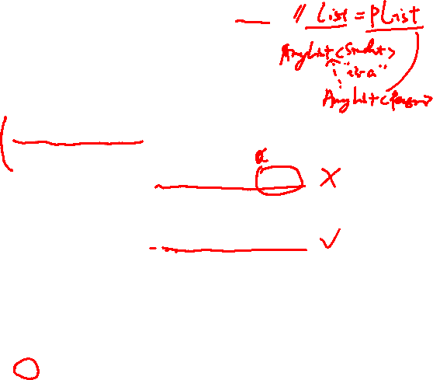
public class WildCardsExe <E extends Person>{
public E findFirst(ArrayList<E> list){
if (list == null || list.size() == 0){
return null;
}
return list.get(0);
}
public static void main(String[] args){
WildCardsExe<Student> ref = new WildCardsExe<Student>();
ArrayList<Person> pList = new ArrayList<Person>();
pList.add(new Person("PC"));
pList.add(new Person(“GM"));
System.out.println(ref.findFirst(pList));
ArrayList<Student> sList = new ArrayList<Student>();
sList.add(new Student("PC", 11));
sList.add(new Student(“GM", 33));
System.out.println(ref.findFirst(sList));
}
}
class Person{
private String name;
public Person(){
name = "paul";
}
public Person(String name){
this.name = name;
}
public String toString(){
return name;
}
}
class Student extends Person{
private int credits;
public Student(){
super();
credits = 12;
}
public Student(String name, int credits){
super(name);
this.credits = credits;
}
public String toString(){
return super.toString() + “ “ + credits;
}
}
What will happen when we try to run this code?
PC PC 11
GM
GM 33
C. Compiler error
D. Runtime error
Notes:
C compiler error as ArrayList<Student> isn’t a subclass of ArrayList<Person>

Slide 7
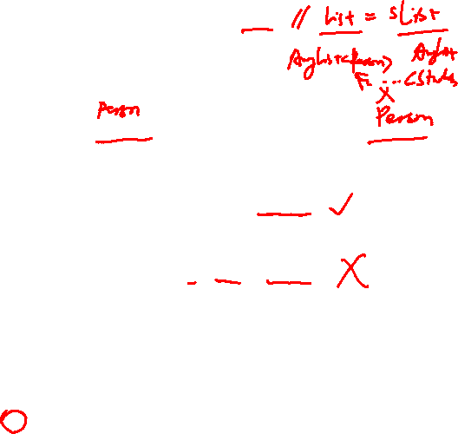
public class WildCardsExe <E extends Person>{
public E findFirst(ArrayList<E> list){
if (list == null || list.size() == 0){
return null;
}
return list.get(0);
}
public static void main(String[] args){
WildCardsExe<Student> ref = new WildCardsExe<Student>();
ArrayList<Person> pList = new ArrayList<Person>();
pList.add(new Person("PC"));
pList.add(new Person(“GM"));
System.out.println(ref.findFirst(pList));
ArrayList<Student> sList = new ArrayList<Student>();
sList.add(new Student("PC", 11));
sList.add(new Student(“GM", 33));
System.out.println(ref.findFirst(sList));
}
}
class Person{
private String name;
public Person(){
name = "paul";
}
public Person(String name){
this.name = name;
}
public String toString(){
return name;
}
}
class Student extends Person{
private int credits;
public Student(){
super();
credits = 12;
}
public Student(String name, int credits){
super(name);
this.credits = credits;
}
public String toString(){
return super.toString() + “ “ + credits;
}
}
If I change the red line to the following, what will happen?
WildCardsExe<Person> ref = new WildCardsExe<Person>();
PC PC 11
GM
GM 33
C. Compiler error
D. Runtime error
Notes:
Still compiler error

Slide 8

Wildcards
Hope
Our generic class should take any type that is a subtype of E
And we hope that findFirst can take ArrayList of any subtype of E
But
Current generic system doesn’t allow that.
public class WildCardsExe <E extends Person>{
public E findFirst(ArrayList<E> list)
Java provides a flexible type – the wildcard – ?
<?> means any type
Collection<?> means Collection of any type
Notes:
Collection<Shapes> does not work as we have discussed.
We would like something that is not restricted to a specific type and extends to a range of types.

Slide 9

Java Wildcards
public class WildCardsExe <E extends Person>{
public E findFirst(ArrayList<? extends E> list){
if (list == null || list.size() == 0){
return null;
}
return list.get(0);
}
public static void main(String[] args){
WildCardsExe<Person> ref = new WildCardsExe<Person>();
ArrayList<Person> pList = new ArrayList<Person>();
pList.add(new Person("PC"));
pList.add(new Person("HA"));
System.out.println(ref.findFirst(pList));
ArrayList<Student> sList = new ArrayList<Student>();
sList.add(new Student("PC", 11));
sList.add(new Student("HA", 33));
System.out.println(ref.findFirst(sList));
}
}
?: unbounded wildcard represents any subtype of E so our ArrayList is more general (it implies ? extends Object)
? extends E : bounded wildcard represents E or any subtype of E
? super E: lower-bounded wildcard represents E or any super type of E

Slide 10

void doIt(Collection<? extends Student> data){
for (Student s: data){
System.out.println(s)
}
}
Does the following code compile?
Collection<Student> data = new ArrayList<Student>();
doIt(data);
Yes
No
Does the following code compile?
Collection<Person> data = new ArrayList<Person>();
doIt(data);
Notes:
First one is yes and second one is no

Slide 11

void doIt(Collection<? extends Student> data){
for (Student s: data){
System.out.println(s)
}
}
Does the following code compile?
Collection<Student> data = new ArrayList<Student>();
doIt(data);
Does the following code compile?
Collection<Person> data = new ArrayList<Person>();
doIt(data);
How do we change doIt such that it will work for both situations
change parameter to Collection<? extends Person> data
change parameter to Collection<? super Student> data
change parameter to Collection<? super Person> data
change foreach loop to for (Object s: data)
Some combination of the above
Notes:
Answer is E
A won’t work because we also need to change the foreach loop to for(Person s: data). Then it will work
B won’t work because we also need to change the foreach loop to for (Object s: data). Simply change to Person s: data won’t work because super of Student can also be Object. So B and D together works
C wont’ work for the Student list example

Slide 12
Unbounded wildcard – ‘?’
static void soundOff(Collection<?> listOfAnimals) {
for (Animal a : listOfAnimals) {
a.makeNoise();
}
}
Collection<Dog> dogList = new ArrayList<Dog>(); soundOff(dogList);
Does this solve our problem?
Yes, this code will work
No, this code has a compile error
Notes:
Have to be Object a: List of Animals
OR
change parameter to Collection<? extends Animal>

Slide 13
addAll should accept collections that contain any type that ‘is-a’ E.
public abstract class AbstractCollection<E> implements Collection<E> {
// Add all the elements of the argument Collection
// to this Collection public boolean addAll(_____ c) {
Collection<E>
Collection<?>
Collection<? extends E>
Collection<? super E>
More than one of these will work
Notes:
C

Slide 14
import java.util.*;
public class SuperWildCardDemo {
public static void main(String[] args) {
ArrayList<String> list1 = new ArrayList<String>();
ArrayList<Object> list2 = new ArrayList<Object>();
list2.add("CSE");
list2.add(12);
list1.add("UCSD");
add(list1, list2);
System.out.println(list2);
}
public static <T> void add(ArrayList<_______> c1, ArrayList<_________> c2) {
while (!c1.isEmpty())
c2.add(c1.remove(0));
}
}
What types should I fill into the blanks
T ? extends T
? extends T T
T ? super T
? super T T
Something else
Notes:
C

Slide 15
Questions on Lecture 23?

